Slide 1

Human Activity Recognition using
S-EMG data and Deep Learning
1
PROJECT END- REVIEW
National Institute of Technology, Warangal
Department of Electronics and Communications Engineering
Supervised By:
Dr. Mohammed Farukh Hashmi
Assistant Professor
Batch A10:
Akella Lakshmana Sai Srikar - 204103
Chinta Phani Rama Vaibhav - 204115
Yagna Satwik - 204178

Slide 2

﻿Table Of Contents
2
1
Introduction
2
Problem Statement
3
Literature Survey
4
Methods and Materials
5
Methodology
6
Results
7
Conclusion & Future Scope

Slide 3
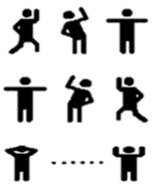
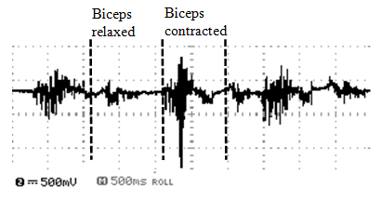
Introduction
3
. Human activity recognition (HAR) has emerged powerful for applications in healthcare, fitness monitoring, and human-computer interaction (HCI)
The identification of activities inducing strain on the muscular system can be accomplished through the analysis of diverse muscle signals such as MMG and EMG.
Out of which surface EMG which is a non invasive method, where in electrical activity of muscles is measured by placing an electrode on the skin above the muscle of interest
Various recognizable activities
EMG Signal

Slide 4
Problem Statement
4
The Aim of the project is to develop a deep learning model that can accurately classify human activities based on surface Electromyography (sEMG) data.
Key Objectives of the project:
Leverage Deep Learning techniques: To investigate the effectiveness of deep learning in harnessing sEMG data for activity classification
Implementation of Different Transfer Learning models
Use of different Time frequency representation techniques
Conference Paper : We also aim to share the research findings through a conference paper ( ICCCNT)

Slide 5
Literature Survey
5
S.No. | AUTHOR & PUBLICATION | RESEARCH PAPER TITLE | COMMENTS/LEARNINGS | GAPS/DRAWBACKS
1 | Fatih Demir et al. Neural Computing and Applications 31(32) (Dec 2019) | Surface EMG signals and deep transfer learning-based physical action classification[1] | This paper, proposed deep transfer learning base approach. SEMG signals were represented by time frequency image using STFT, it is used a input for CNN models namely AlexNet and VGG16 for deep feature extraction and SVM classifier is used for classification | Instead of STFT other transforms like wavelet could have been used, fine tuning of Alex Net model is needed for higher accuracies.
2 | A. Vijayvargiya, et al. Mathematical Problems in Engineering (Nov 2022) | Hybrid Deep Learning Approaches for sEMG Signal-Based Lower Limb Activity Recognition[2] | The signal is segmented with overlapping windows. The preprocessing technique, wavelet denoising, is applied to clean the sEMG signal. Hybrid deep learning models, specifically CNN-LSTM and CNN-GRU, are proposed for lower limb activity recognition. | The dataset contained only 3 activities and more number of epochs were run which take more time and computational ability

Slide 6
6
S.No. | AUTHOR & PUBLICATION | RESEARCH PAPER TITLE | COMMENTS/LEARNINGS | GAPS/DRAWBACKS
3 | Sakorn Mekruksavanich, Ponnipa Jantawong, Anuchit Jitpattanakul, Procedia Computer Science, Volume 214, 2022,) | A Deep Learning-based Model for Human Activity Recognition using Biosensors embedded into a Smart Knee Bandage[3] | This paper proposes a ResNeXt model with multiple bio-signal data like EMG and EGM for classification and HAR. They integrated features from EMG, EGM and IMU to find a maximum accuracy of 91.60% | ResNext Model is a heavy deep learning model ,it typically requires more computational resources for training and inference due to its deeper and more complex structure. So architectures like mobilenet and VGG16 are much better for complexity classification
4 | H. Alaskar, International Journal of computer science and Network Security, Vol. 18 No. 12 (2018) | Deep Learning of EMG Time–Frequency Representations for Identifying Normal and Aggressive Actions [4] | This paper analyses two Time Frequency methods along with three CNN architectures to find the optimal performance. They find that using Scalogram images to train CNNs achieved highest accuracy. of 94% | Instead of using CNN models, it might have been better to use other types of image models like Mobilenet, which focus more on the spectrum of the image.

Slide 7
7
S.No. | AUTHOR & PUBLICATION | RESEARCH PAPER TITLE | COMMENTS/LEARNINGS | GAPS/DRAWBACKS
5 | Shuya ide et al. AIP Advances journal (May 2023) | Analysis of aging effect on lower limb muscle activity using short time Fourier transform and wavelet decomposition of electromyography signal[5] | Surface electromyography (EMG) and analysis techniques like short time Fourier transform (STFT) and Wavelet Transform (WT) aid in muscle activity analysis .Muscle weakening plays a significant role in knee osteoarthritis (OA) development, emphasizing the need for early detection and tailored treatments. | Limited sample size of 84 participants may affect the study's applicability to broader populations. EMG technology and analysis techniques may not fully capture muscle activity complexity during movements.
6 | K. Nurhanim, I. Elamvazuthi, L. I. Izhar, G. Capi and S. Su, 2021 8th NAFOSTED Conference on Information and Computer Science (NICS), Hanoi, Vietnam, 2021 | EMG Signals Classification on Human Activity Recognition using Machine Learning Algorithm | This paper studies Activity classification using Random Forest algorithm, they use a dataset with left and right upper leg muscles and achieve an accuracy of 82.08% | Instead of employing six activities from two channels to achieve an accuracy of 82.08%, adopting an adaptive deep learning model such as AlexNet or VGG16, supplemented with additional data, could potentially enhance our operational efficiency.

Slide 8
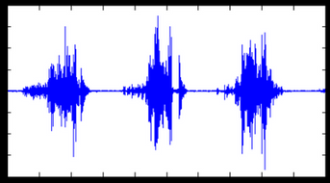


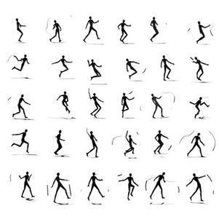
Methodology
8
Random Forest, CNN, LSTM, CNN+LSTM
Raw EMG Signal
Pre-Processing
Model Training
Classification
Normalization
Denoising
Activity Recognition
Detection of Activity
Notes:
1.7.2013
‹#›

Slide 9
Methodology
8
Time Frequency Analysis
Feature Extraction
Raw EMG Signal
Dimensionality Reduction
Classification
Short Time Fourier Transform (STFT)
Transfer Learning
Principal Component Analysis
Fully Connected Layers
Pre-Processing
Denoising
Normalization
Synchro Squeezing
Feature Extraction
Classification
Activity Recognition
2D CNN
Detection of Activity
Notes:
1.7.2013
‹#›

Slide 10
Methods and Materials
9
Datasets
EMG datasets by UCI is used to develop and train classifiers and deep learning models for future use on real time data.
The UCI EMG Physical Action Data Set [7] includes 10 normal and 10 aggressive physical actions that measure the human activity. The data have been collected from 4 subjects using the Delsys EMG wireless apparatus.
The data acquisition process involved eight skin-surface electrodes placed on the upper arms (biceps and triceps), and upper legs (thighs and hamstrings).
The other dataset also is from UCI ML Repository of EMG lower limb data [8], consisting of 22 subjects performing 3 activities, it is used to verify if the models are not overfitting and are accurate enough for EMG signals in general.

Slide 11
Random Forest and DL Models
13
Random Forest: Random forest is a powerful ensemble learning algorithm that builds multiple decision trees and combines their predictions to improve accuracy and reduce overfitting. It is widely used in classification and regression tasks across various domains due to its robustness and ability to handle large datasets.
CNN: These efficient algorithms excel in image recognition, detecting edges and textures with minimal computational complexity, ideal for accurate analysis of large datasets.
LSTM: These networks process data sequences efficiently by selectively retaining or forgetting information over time through gates, lessening computational load and prioritizing pertinent details.
Notes:
1.7.2013
‹#›

Slide 12
Random Forest and DL Models
13
CNN+LSTM : By enabling the CNN to learn spatial features initially, this model streamlines computations, diminishing the complexity of subsequent LSTM layers. Consequently, it offers an efficient approach for comprehending both spatial and temporal aspects of the data.Thus making it more efficient.
CNN +STFT: Combining CNN with STFT (Short-Time Fourier Transform) optimizes efficiency by extracting both spatial and frequency-domain features in one step, reducing computation while enhancing accuracy in tasks like Image classification or speech recognition.
Notes:
1.7.2013
‹#›

Slide 13
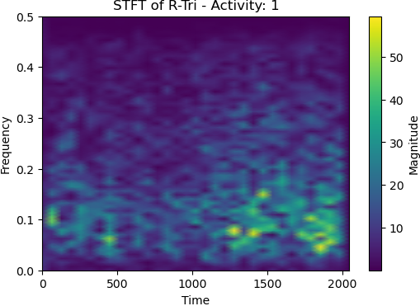
Time Frequency Analysis
10
A spectrogram is a visual representation of this analysis derived from STFT (Short Time Fourier Transform). It holds a number of unknown features of EMG signals.
The spectrogram is a series of sinusoidal functions varying with time. Different colors represent different energy values.
The original sEMG signals have 10,000 samples, and the length of the sampling window is 2000 samples/sec. The sampled sEMG signals are then converted into the color images
spectrogram for the bowing data of
subject 1, channel 1​,

Slide 14
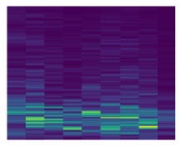
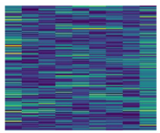
12
SynchorSqueezing Short Time Fourier Transform
Synchrosqueezing: Improves on Short-Time Fourier Transforms (STFT) by reducing uncertainty in the time-frequency domain.
Synchrosqueezing Transform (SST) Goals:
Concentrates complex signals in the time-frequency plane.
Separates and extracts different signal components.
Optimizing STFT: Adjusting STFT parameters helps focus on the most relevant information for the model.
Synchrosqueezing Benefit: By rearranging energy in the time-frequency plane, it improves component localization, making the signal easier to understand and use.
(a) STFT
(b) SS- STFT

Slide 15
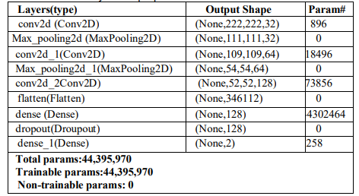
12
SS-STFT + 2D CNN
Model Summary of 2D CNN model with SS-STFT

Slide 16
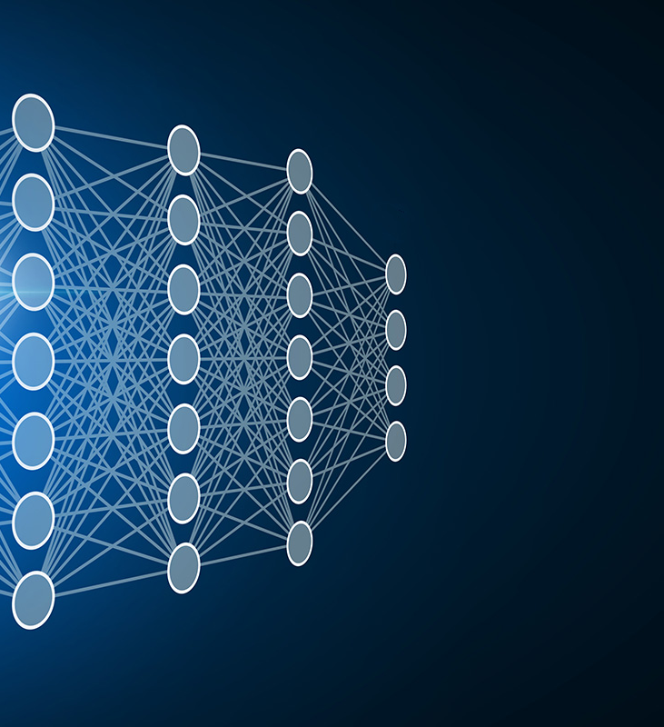
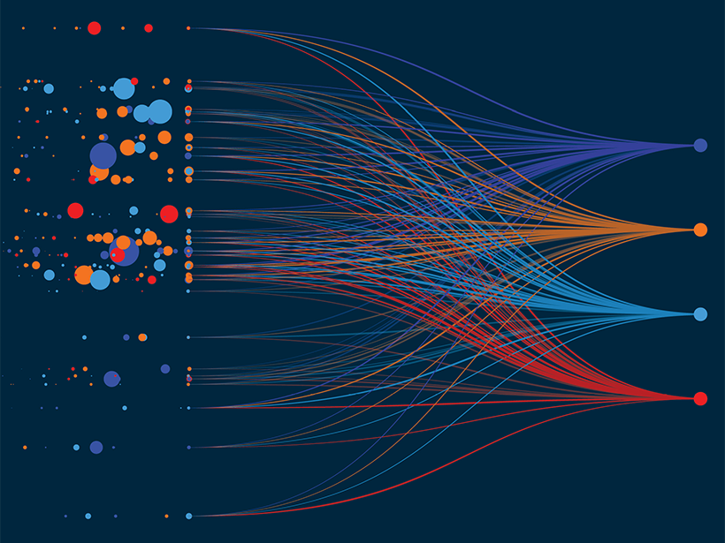
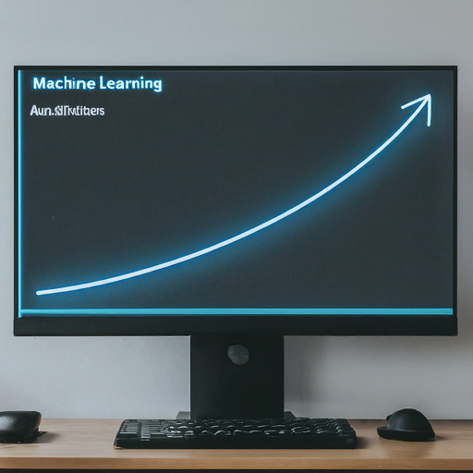
Transfer Learning
Transfer Learning is a technique where a pre-trained model which has already been trained on huge dataset are used for a new custom task . Here are some advantages of transfer learning
Reduced Training Time: Since the initial model is already pre-trained on a large dataset, the overall training time for the target task is reduced.
Improved Performance: Transfer learning can improve the performance of the model, especially when the target task has limited data. The pre-trained model already captures useful patterns and representations from a related task, which aids the learning process.
Better Generalization: Transfer learning can help the model generalize better to new, unseen data by learning more robust and meaningful features

Slide 17
ImageNet Models
13
VGG19: A deep convolutional neural network known for its good performance, but with a larger size and higher computational cost.
MobileNet: A lightweight and efficient model designed for mobile applications and devices with limited resources.
InceptionV3: Achieves high accuracy with a unique architecture using inception modules for efficient feature extraction.
DenseNet: Connects layers more densely, promoting better feature reuse and potentially improving accuracy.
ResNet-50: A deep residual neural network with skip connections that help address the vanishing gradient problem in deep architectures.
Notes:
1.7.2013
‹#›

Slide 18


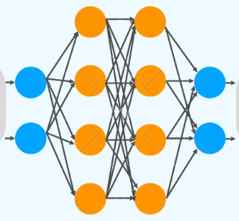


Transfer Learning
11
Transfer Learning
Principal
Component
Analysis
Feature
Concatenation
Classified
Activity
Labels
Pre Trained Layers
of ImageNet models
Fully Connected Layers
(Dense & Dropout)
Time Frequency Images (STFT)
Notes:
1.7.2013
‹#›

Slide 19


Principal Component Analysis
14
As the number of dimensions increases, the number of possible combinations of features increases exponentially, which makes it computationally difficult to perform tasks like classification.
Dimensionality reduction is a type of feature extraction technique that aims to reduce the number of input features while retaining as much of the original information as possible.
One of the most popular dimensionality reduction techniques is Principal Component Analysis(PCA).
Compute eigen values and eigen vectors
Covariance Matrix Computation
Identify principal components
Standardization

Slide 20
Steps of PCA
15
Step 1: Standardization
First, we need to standardize our dataset to ensure that each variable has a
mean of 0 and a standard deviation of 1.
Step2: Covariance Matrix Computation
Covariance measures the strength of joint variability between two or more
variables, indicating how much they change in relation to each other. The value of
covariance can be positive, negative, or zeros.
Positive: As the x1 increases x2 also increases.
Negative: As the x1 increases x2 also decreases.
Zeros: No direct relation
Step 3: Compute Eigenvalues and Eigenvectors of Covariance Matrix
Step 4: Identify Principal Components

Slide 21
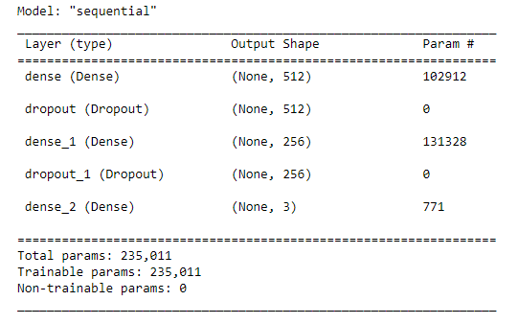
Feature Concatenation
16
Feature concatenation in transfer learning with different models like MobileNet, Inception, etc., involves merging the features extracted from multiple pre-trained models into a single feature vector.
This approach allows for capturing diverse and complementary representations learned by each model. By concatenating these features, the resulting representation can potentially capture a broader range of patterns and semantics, leading to improved performance.
Fully connected layers mainly consist of dense and drop out layers

Slide 22
Results – Sem 1
17
Model | TP | FP | FN | TN | Accuracy | Precision | Recall | F1 SCORE
RF | 87 | 13 | 6 | 94 | 90.5 | 87 | 93.54 | 90.15
CNN | 82 | 18 | 15 | 85 | 83.5 | 82 | 84.54 | 83.25
LSTM | 87 | 13 | 10 | 90 | 88.5 | 87 | 89.69 | 88.32
CNN+LSTM | 89 | 11 | 7 | 93 | 91 | 89 | 92.70 | 90.81
STFT+CNN | 96 | 4 | 6 | 94 | 95 | 96 | 94.11 | 95.04

Slide 23
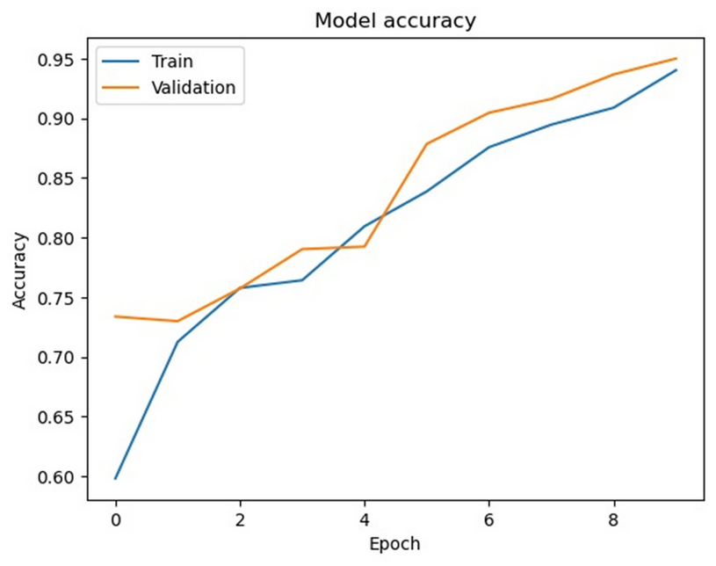
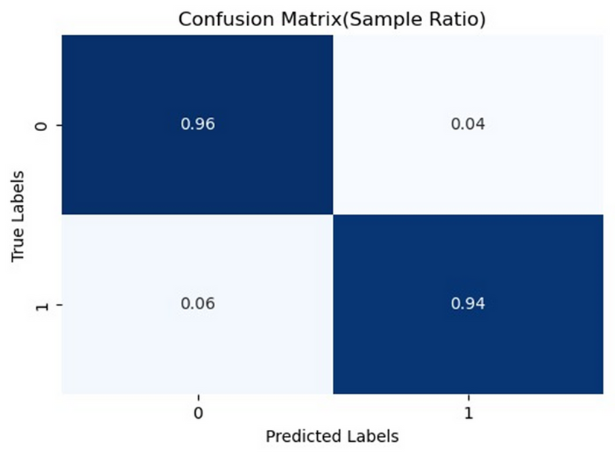
Results - Sem 1
18
Confusion Matrix of STFT+CNN
Training and validation accuracy graph

Slide 24
Results - Sem 2
19
Model | Number of features Extracted | Time taken for each step in ms | Fully connected layer accuracy | Fully connected layer accuracy | Fully connected layer accuracy
Model | Number of features Extracted | Time taken for each step in ms | CNN | lSTM | GRU
MobileNet | 50176 | 50 | 97.34 | 96.71 | 96.82
VGG19 | 25088 | 150 | 95.67 | 95.88 | 95.68
DenseNet | 50716 | 150 | 97.13 | 96.45 | 96.14
ResNet50 | 100352 | 150 | 97.03 | 97.08 | 96.45
Inceptionv3 | 131072 | 170 | 96.71 | 96.04 | 96.14

Slide 25
Results - Sem 2
20
Dataset | Fully connected layer accuracy (Concatenated Features) | Fully connected layer accuracy (Concatenated Features) | Fully connected layer accuracy (Concatenated Features)
Dataset | CNN | lSTM | GRU
EMG Physical Action Dataset | 98.85 | 98.85 | 97.91
EMG HAR dataset | 92.42 | 92.80 | 93.56

Slide 26
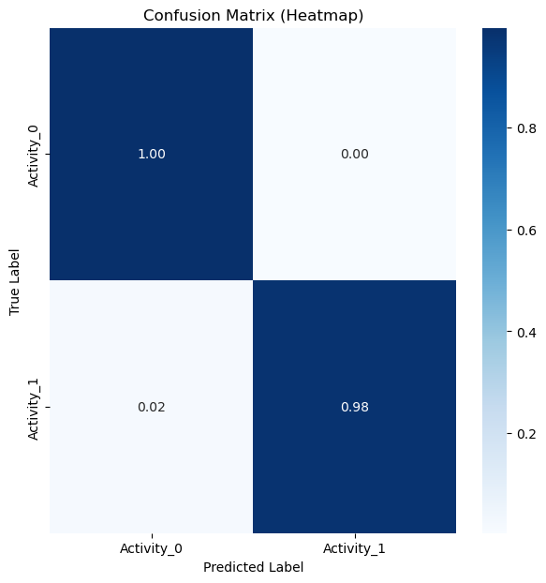
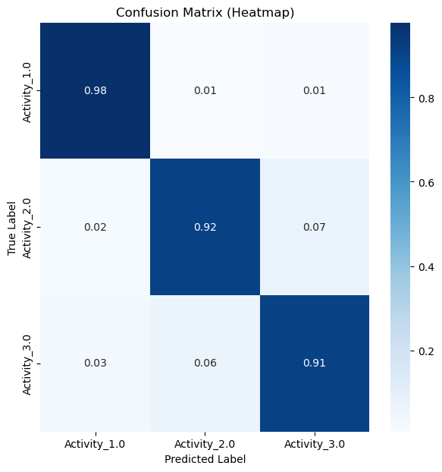
Results -TL
21
Confusion Matrix of EMG physical action
Confusion Matrix of EMG HAR dataset

Slide 27
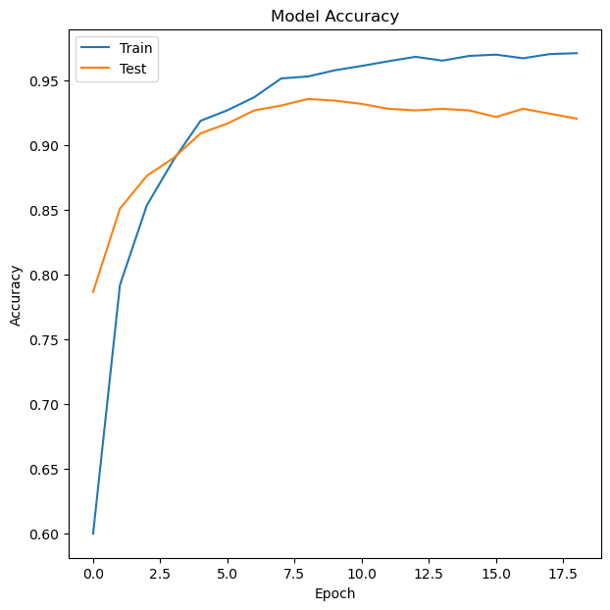
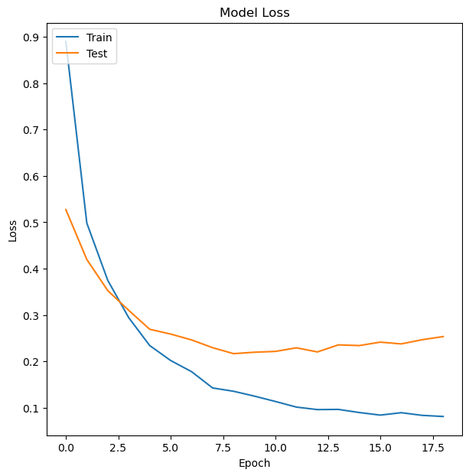
Results-HAR
22
Training and validation accuracy graph
Training and validation loss graph

Slide 28
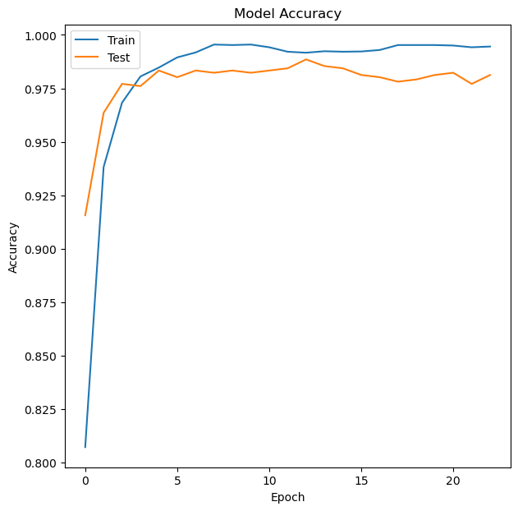
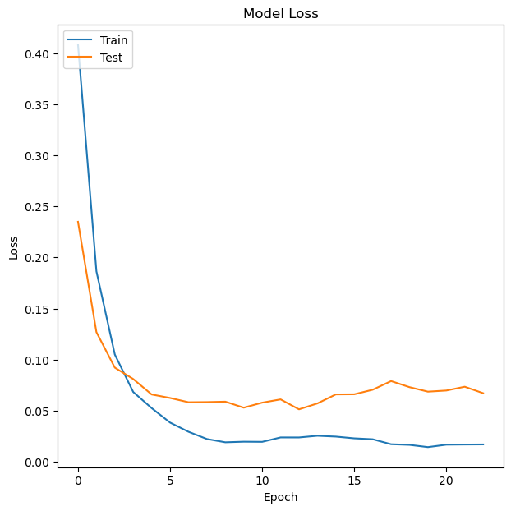
Results-Physical action
23
Training and validation accuracy graph
Training and validation loss graph

Slide 29
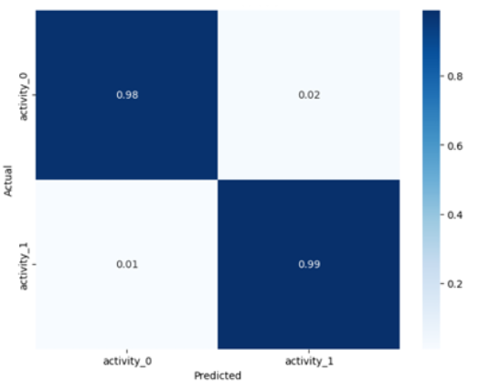
Results - SS-STFT
Accuracy | Precision | Recall | F1 Score
0.985 | 0.98 | 0.9898 | 0.9848
Confusion matrix of 2D-CNN with SS-STFT as input

Slide 30
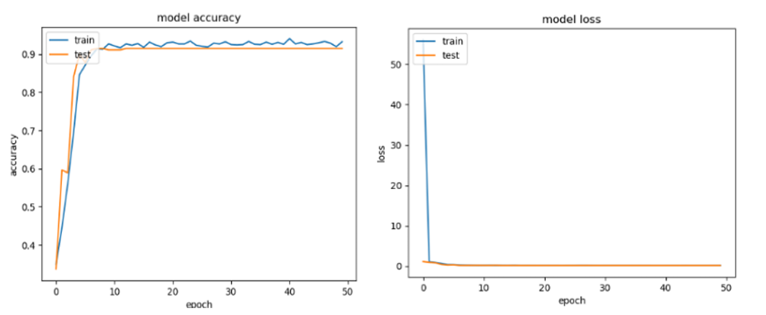
Results SS-STFT images input
23
Training and Testing accuracy per epoch
Training and Testing Loss per epoch

Slide 31
Conclusion
27
for raw EMG data in sequential time series format CNN+LSTM model worked the best according to traditional Machine Learning approaches, with an accuracy of 91%. It combined the best parts of both the models,
Moving further we employed Transfer Learning models on both the EMG physical action dataset and EMG dataset in lower limb. MobileNet provided the best results with efficient, light weight and high accuracies on both the datasets without overfitting. The MobileNet + CNN model gave an accuracy of 97.34%.
The combination of STFT+SS+CNN produced the most promising results for lower limb muscle activity analysis through sEMG signals, achieving an impressive 98.56% accuracy on the dataset.

Slide 32
Future Scope
27
Real time data collection
- collection of real time EMG data form subjects with Sarcopenia from hospital to increase the prediction accuracy of the developed model.
Denoising of EMG signal
- sEMG signals are susceptible to various noise sources, such as crosstalk from other bioelectrical signals (EEG, ECG) or equipment interference.
Testing of computationally intensive transfer learning models
- exploring models with higher computational intensity could potentially lead to further performance gains.

Slide 33
References
29
[1]
Demir, Fatih & Bajaj, Varun & Ince, Melih & Taran, Sachin & Sengur, Abdulkadir. (2019). Surface EMG signals and deep transfer learning-based physical action classification. Neural Computing and Applications. 31. 10.1007/s00521-019-04553-7.
[2]
A. Vijayvargiya, B. Singh, R. Kumar, U. Desai, and J. Hemanth, ‘Hybrid Deep Learning Approaches for sEMG Signal-Based Lower Limb Activity Recognition’, Mathematical Problems in Engineering, vol. 2022, p. 3321810, Nov. 2022.
[3]
Vijayvargiya, Ankit & Singh, Puneet & Kumar, Rajesh & Dey, Nilanjan. (2022). Hardware Implementation for Lower Limb Surface EMG Measurement and Analysis Using Explainable AI for Activity Recognition. IEEE Transactions on Instrumentation and Measurement. 71. 1-1. 10.1109/TIM.2022.3198443.
[4]
K. Nurhanim, I. Elamvazuthi, L. I. Izhar, G. Capi and S. Su, "EMG Signals Classification on Human Activity Recognition using Machine Learning Algorithm," 2021 8th NAFOSTED Conference on Information and Computer Science (NICS), Hanoi, Vietnam, 2021, pp. 369-373, doi: 10.1109/NICS54270.2021.9701461.

Slide 34
29
[5]
Khan, Md & Moznuzzaman, Md & Ide, Shuya. (2023). Analysis of aging effect on lower limb muscle activity using short time Fourier transform and wavelet decomposition of electromyography signal. AIP Advances. 13. 10.1063/5.0148044.
[6]
Chen, I-Miao & Yeh, Pin-Yu & Chang, Ting-Chi & Hsieh, Ya-Chu & Chin, Chiun-Li. (2022). Sarcopenia Recognition System Combined with Electromyography and Gait Obtained by the Multiple Sensor Module and Deep Learning Algorithm. Sensors and Materials. 34. 2403. 10.18494/SAM3787.
[7]
Theodoridis,Theo. (2011). EMG Physical Action Data Set. UCI Machine Learning Repository. https://doi.org/10.24432/C53W49.
[8]
Sanchez,Oscar and Sotelo,Jose. (2014). EMG dataset in Lower Limb. UCI Machine Learning Repository. https://doi.org/10.24432/C5ZW3P.

Slide 35
30
Thank You

